Slide 1
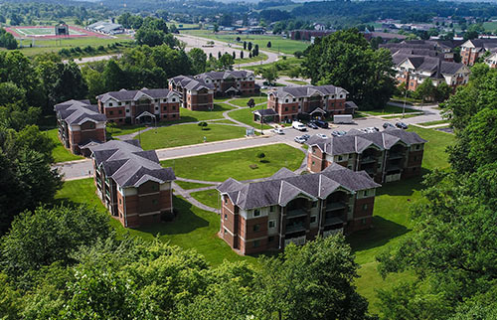
On-Campus Housing ROCK Apartments Overview

Slide 2
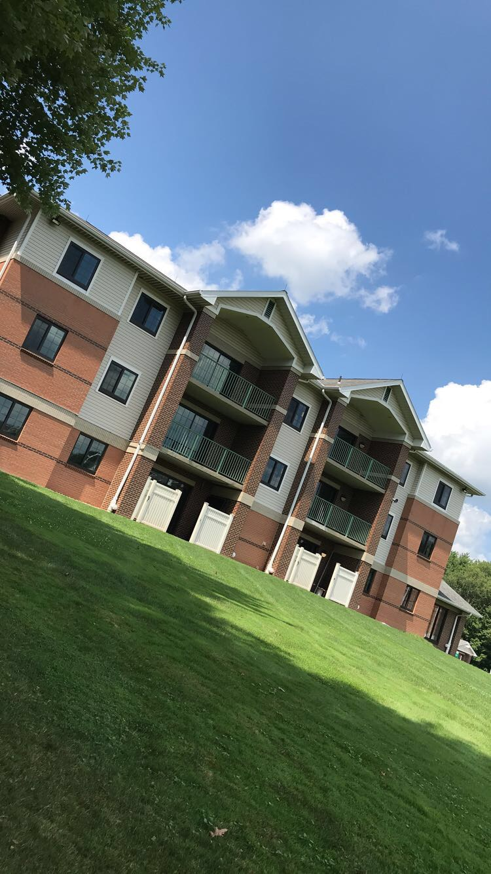
On-Campus Housing: ROCK Apartments
On Campus, Convenient
For upper-class students, must have 30 completed credits at time of application*.
Fully Furnished
Full Kitchen No Meal Plan Required. But optional.
No Monthly Bills
Agreement process is *October for following August
9 month lease
Options for summer school. Sign up mid-March

Slide 3
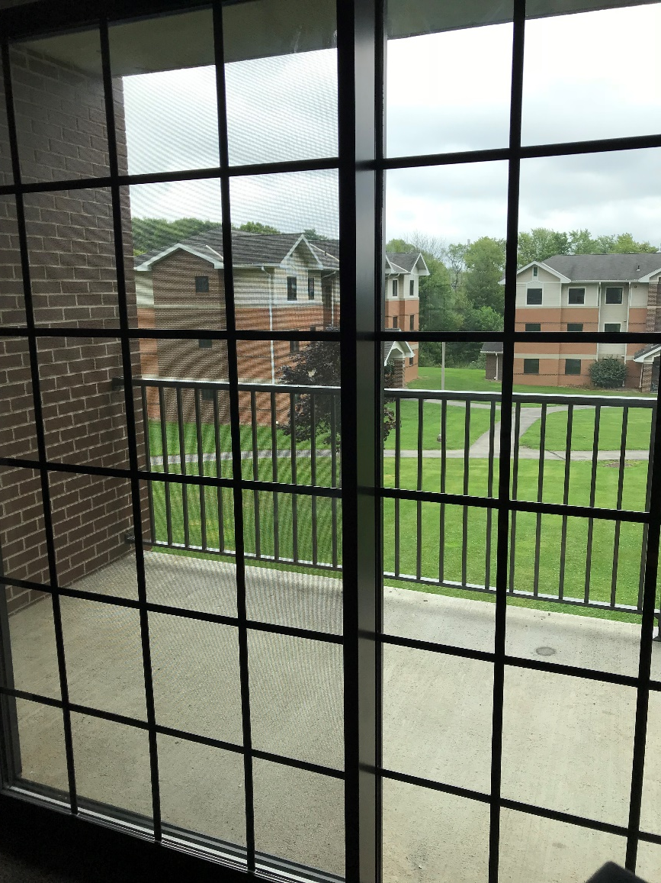
On-Campus Housing: ROCK Apartments
4 Private Bedrooms
Shared Restroom: Separate Shower and Toilet Area within Restroom
Renovated in 2019. New HVAC system completed 2023.
8 Buildings, 6 apartments per building. 3 floors; no elevators.

Slide 4
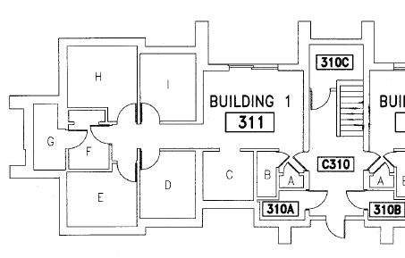
Example Building 310
311 – Apartment 1
311/312 first floor; 313/314 second, 315/316 third.
Typical Layout:
310C = Shared laundry
A/B = Closets
C = Kitchen
D = Bedroom A
E= Bedroom B
H = Bedroom C
I =Bedroom D
F/G= Restroom

Slide 5
KITCHEN
Pictured on next slide
Each apartment has a full kitchen
Self-Cleaning Range/Oven
Full Size Refrigerator/Freezer
Microwave
Dishwasher*
Double Sink
No meal plan is required, but available. Some students choose a commuter/flex plan.
* Please note: Apartments 311, 342, and 352 are ADA compliant. These apartments have a slightly different set up. There is more cabinet space in the kitchen for those residents needing wheelchair assistance so there is no dishwasher installed. The shower area is a roll in shower shared with a toilet.

Slide 6
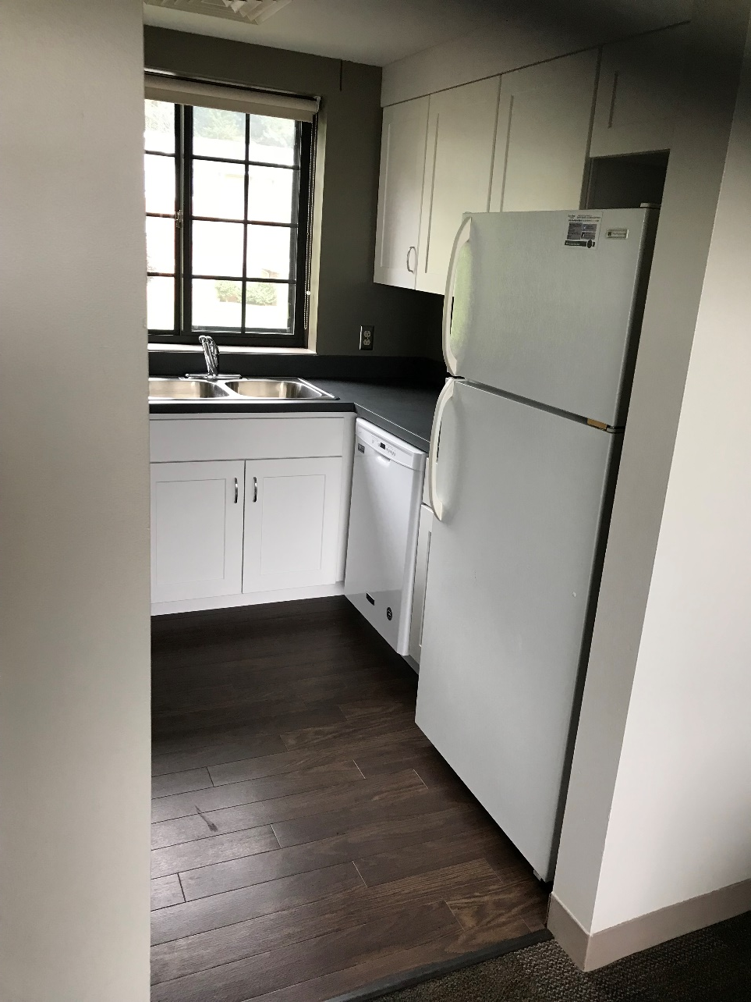
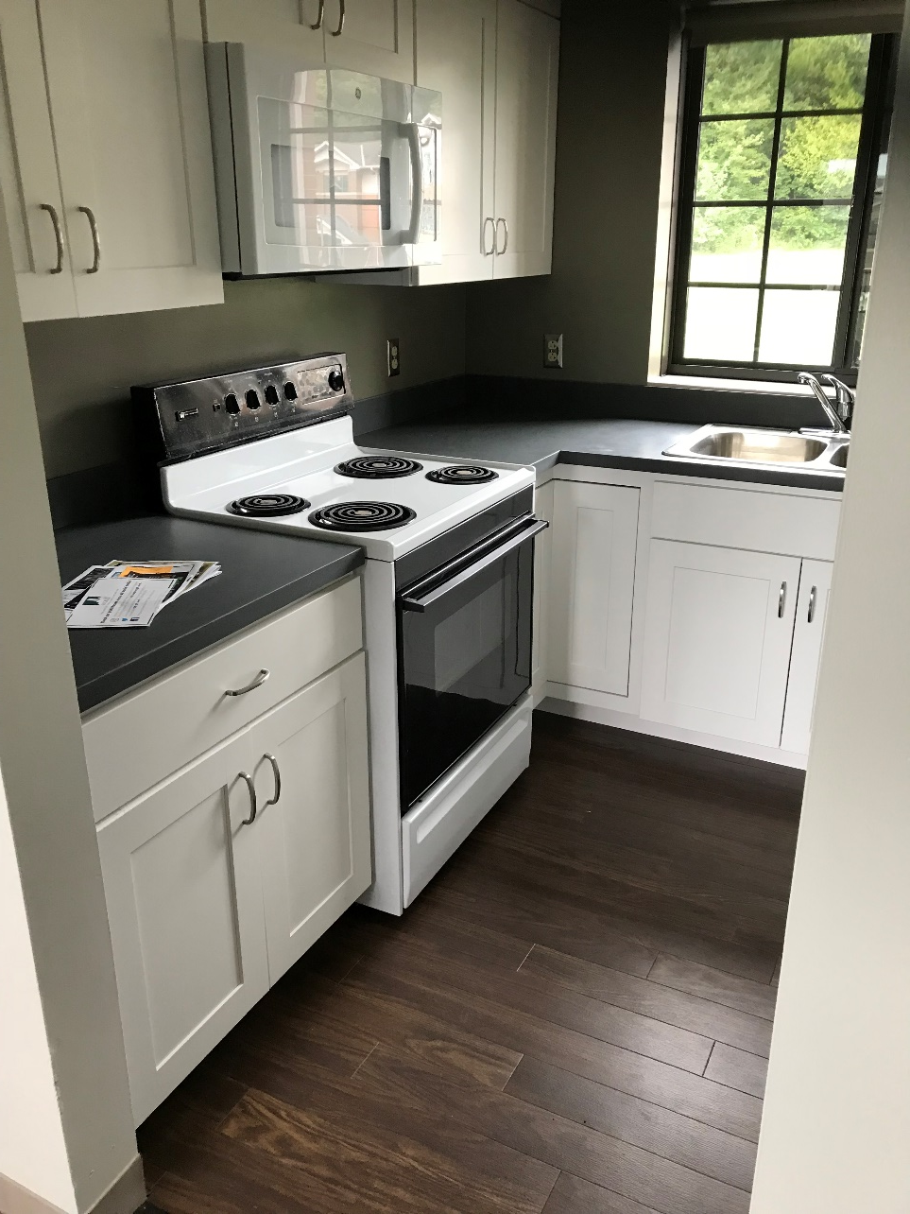

Slide 7
BATHROOM
Pictured on next slide
Separate shower area
Separate toilet area
2 sinks
Linen Closet
Residents provide own shower curtain
* Please note: Apartments 311, 342, and 352 are ADA compliant. These apartments have a slightly different set up. The The shower area is a roll in shower shared with a toilet.

Slide 8
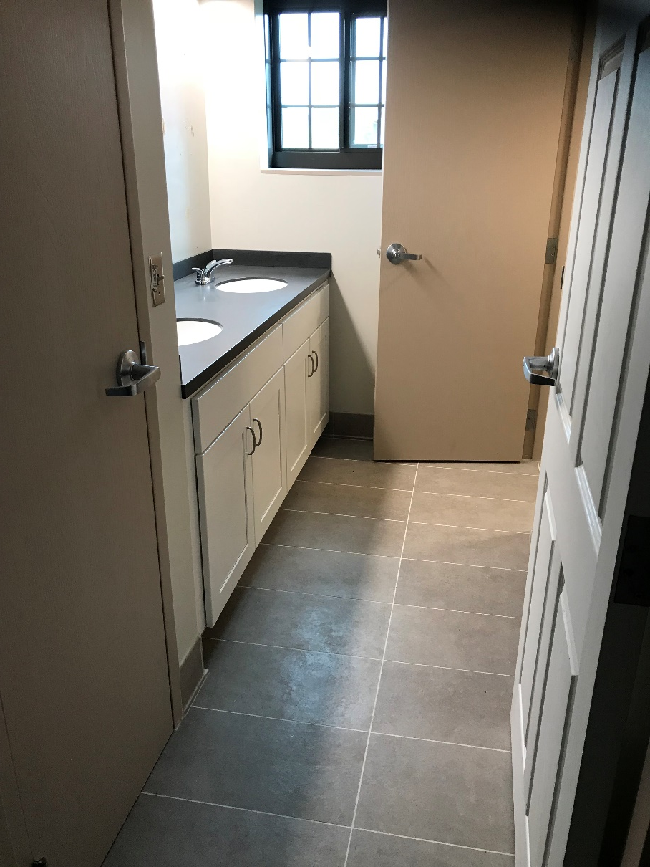
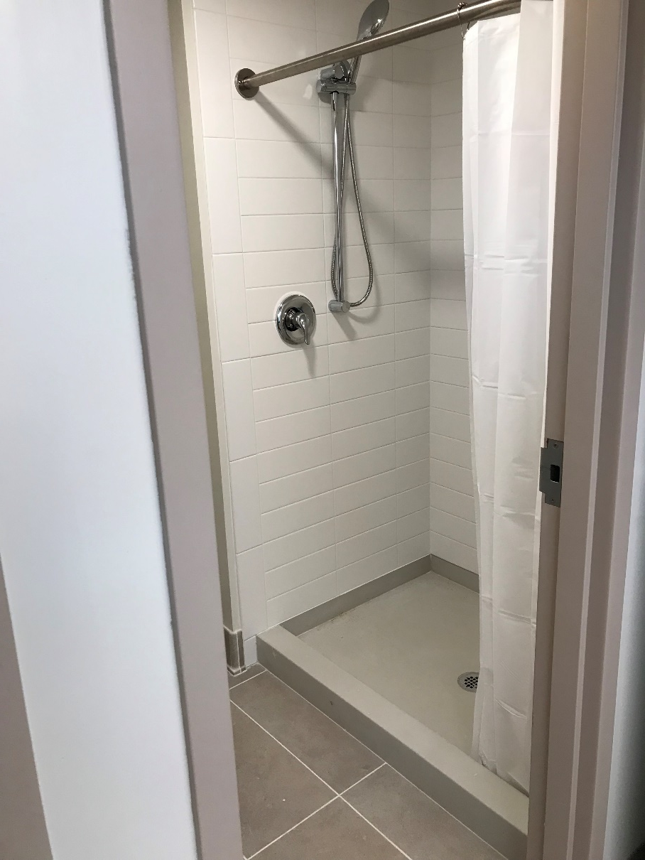

Slide 9
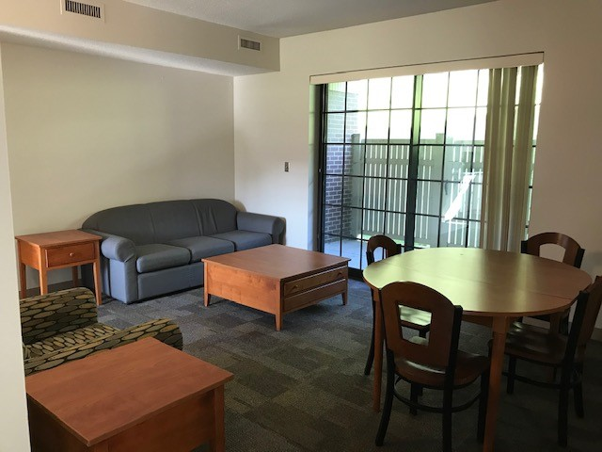
Living Room: All furniture shown is included.
In Background: First floor apartments have patios, upper floors have balconies.

Slide 10
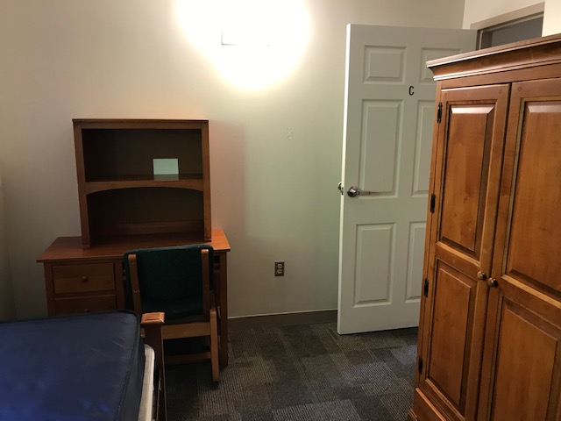
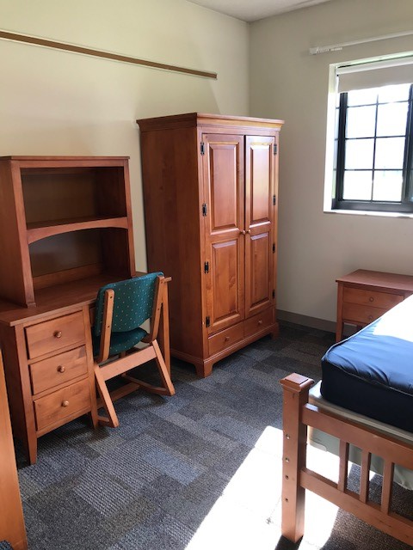
Single Bedroom. Includes wardrobe, desk/chair, bookcase, 4 drawer dresser, twin XL bed. Window shade included.

Slide 11
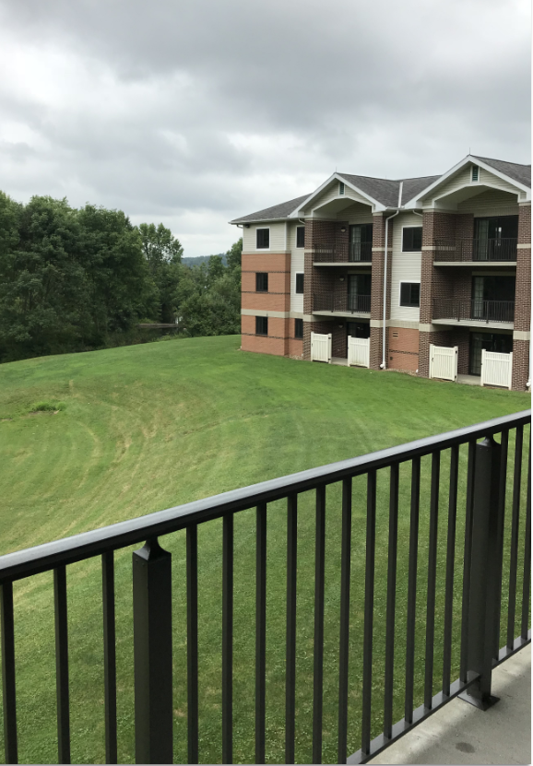
For Fall/Spring:
$250.00 deposit to reserve
$2841.00 per semester
Detailed process will outlined on website.
Laundry room on first floor for each building
Office and Mailroom in glass annex of Building 350

Slide 12
Contact:
Office of Housing
724.738.2082
housing @sru.edu

