Slide 1
CITI Training
Casey Hyatt, Secretary
Institutional Review Board

Slide 2
CITI ONLINE TRAINING COURSE
Federal Regulations require that all participating researchers complete a training course on the protection of human participants in research. SRU subscribes to Collaborative Institutional Training Initiative (CITI) Online Training Program to comply with this regulation.
CITI training certificates for all researchers must be attached to the protocol that is being submitted.
Training certificates expire every 3 years.
Choosing a Course:
Social & Behavioral Research Course – the majority of research at SRU falls under this module. Research involving surveys, observation of human behavior, etc. are covered in this module.
Human Subjects Biomedical Course – for researchers doing more invasive research.
Students Conducting No More than Minimal Risk Research – students conducting Action Research projects.

Slide 3
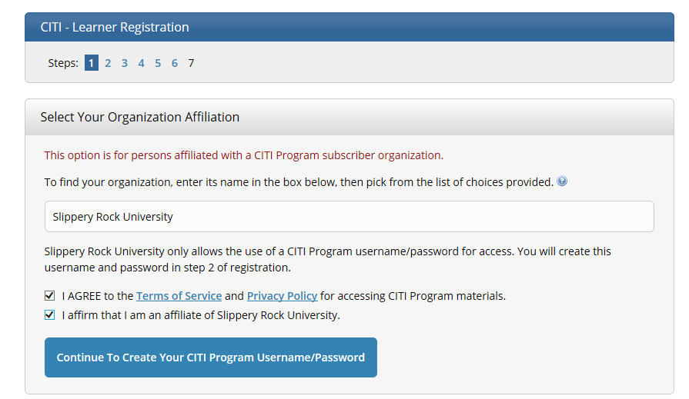
Step 1: Select SRU as your institution
CITI Website: https://about.citiprogram.org/en/homepage/
Agree to the Terms and Service and affirm that you are an affiliate of SRU.

Slide 4
Step 2: Enter Name and Email Address

Slide 5
Step 3: Create User Name/Password and Security Question

Slide 6
Step 4: Enter USA for Country of Residence

Slide 7
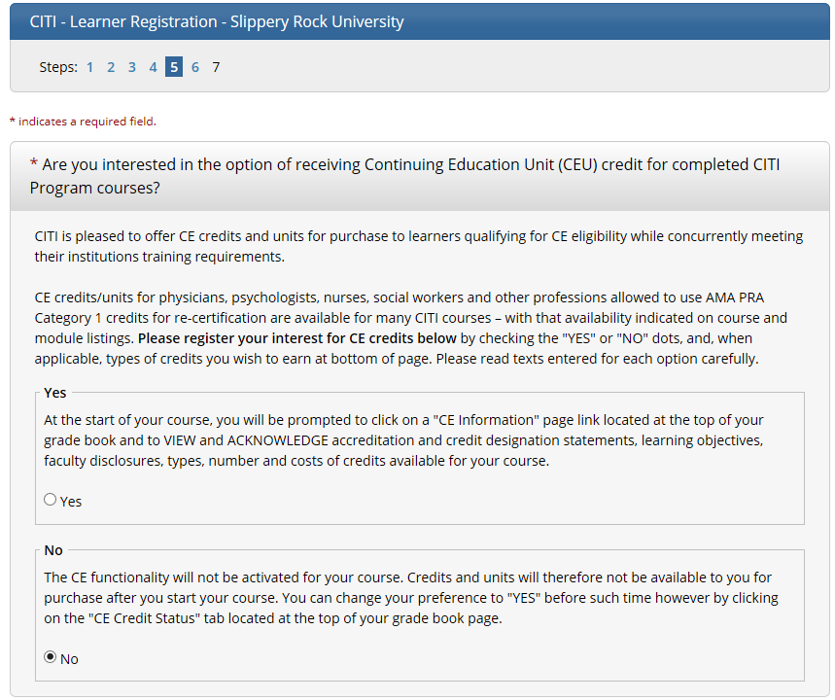
Step 5: Select ‘No’ for CE credits

Slide 8
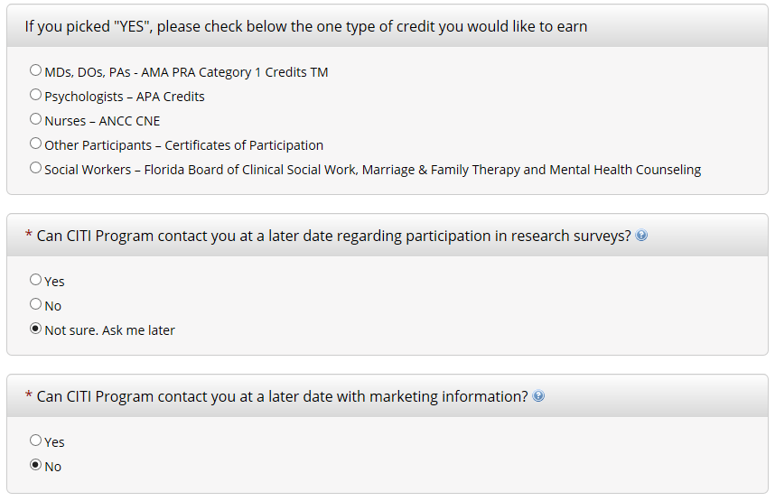
Step 5 (continued): Answer CITI Questions

Slide 9
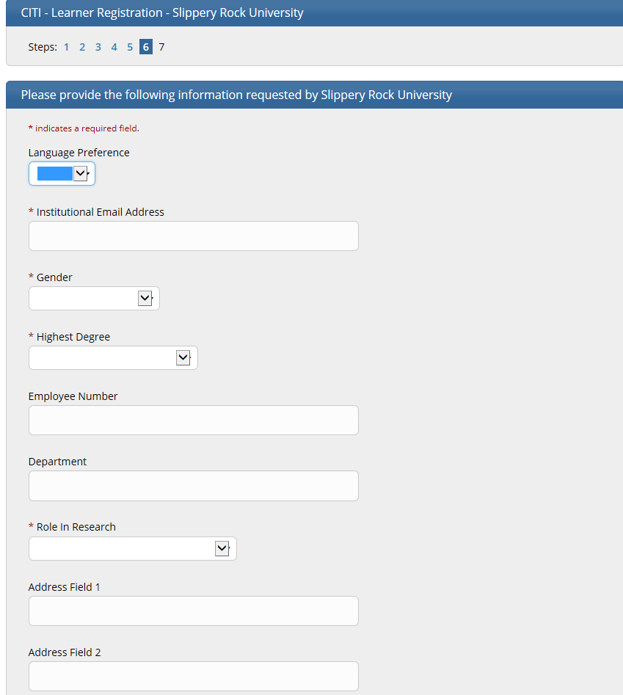
Step 6: Provide the following information

Slide 10
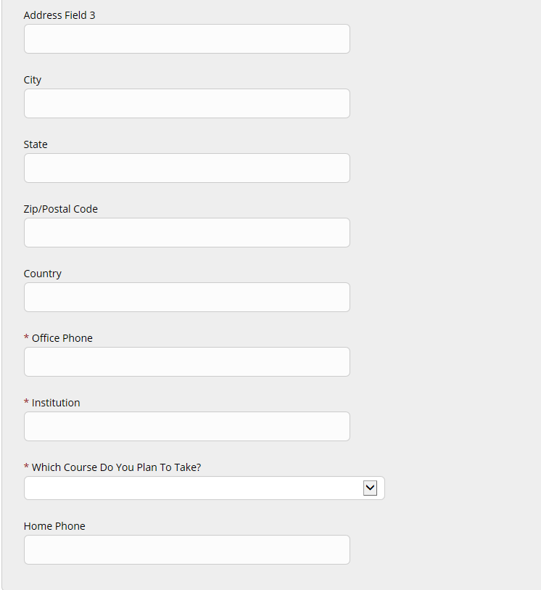
Step 6 (continued): Provide the following information

Slide 11
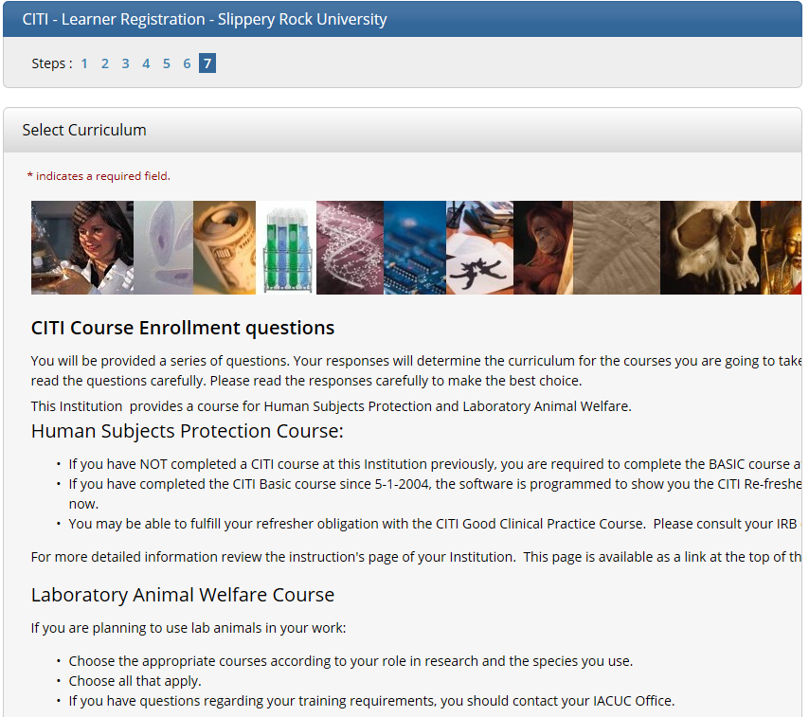
Step 7: Human Subjects Course Info

Slide 12
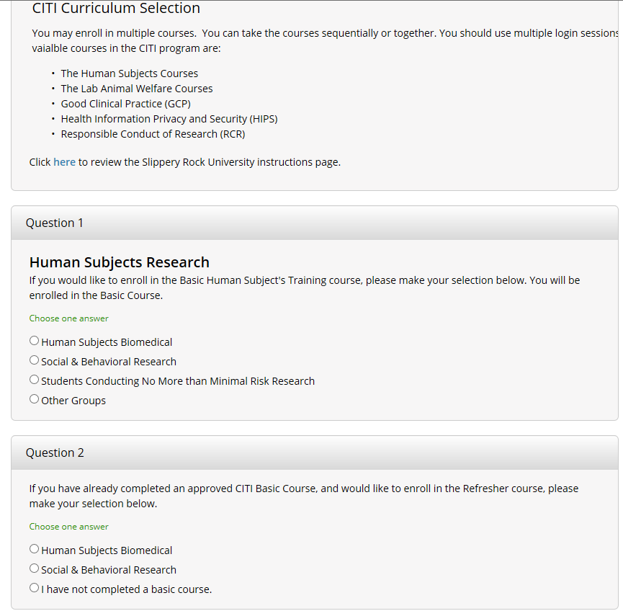
Step 7 (continued): Choose Course
Refer back to slide 2 for help on which course to choose
If you haven’t completed a course in the past, choose the 3rd option

Slide 13
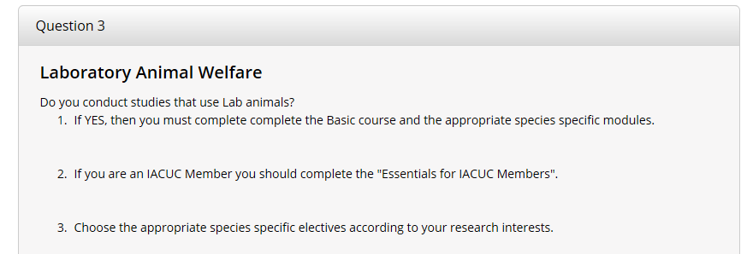
Step 7 (continued): Working with Animals
You will not choose any items in this section

Slide 14
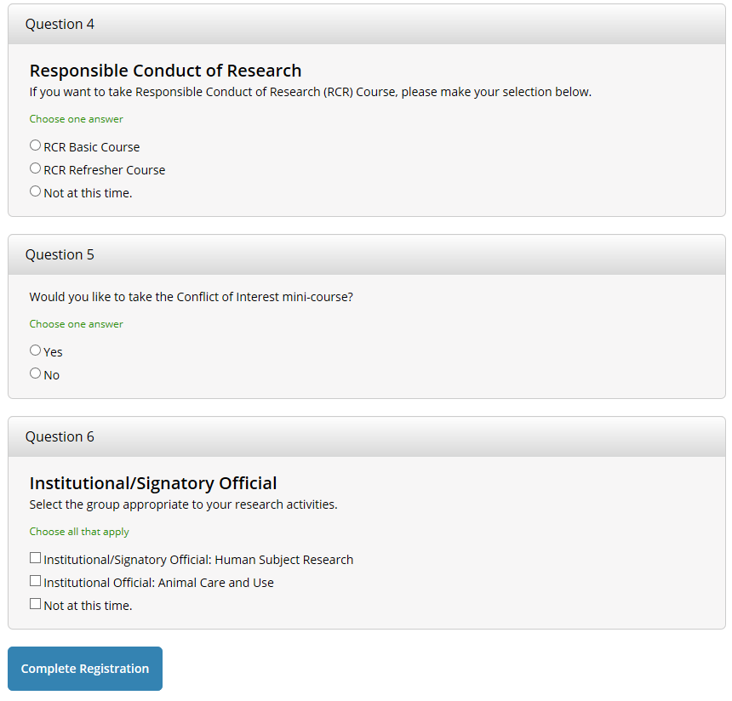
Step 7 (continued): Answer ‘NO’ to these questions
RCR and Conflict of Interest are only required for Federally funded projects.
Institutional Official Course is only for SRU’s Provost to complete.

